Slide 1
Lesson 2: Creating and Running Spring Boot Applications
2.1 Creating a Simple Application Using Spring Boot CLI
2.2 Creating a Web Application Using Spring Boot CLI
2.3 Creating a Web Application Using IntelliJ
2.4 Implementing a Simple REST Service
2.5 Understanding Application Properties

Slide 2
Lesson 2: Creating and Running Spring Boot Applications
2.1 Creating a Simple Application Using Spring Boot CLI

Slide 3
Overview of Spring Boot CLI
Spring Boot CLI is a command-line tool for creating and running Spring Boot applications
Generates a template application in Java or Groovy
Download from:
https://repo.spring.io/release/ org/springframework/boot/ spring-boot-cli/

Slide 4
Using Spring Boot CLI
After downloading Spring Boot CLI:
Add the /bin folder to your path
Verify correct installation:
spring --version

Slide 5
Creating a Simple Spring Boot App
Create a simple Spring Boot app as follows:
Spring CLI calls https://start.spring.io
Returns a Spring Boot app (zipped)
Spring CLI unzips into specified folder
spring init --build maven mysimpleapp

Slide 6
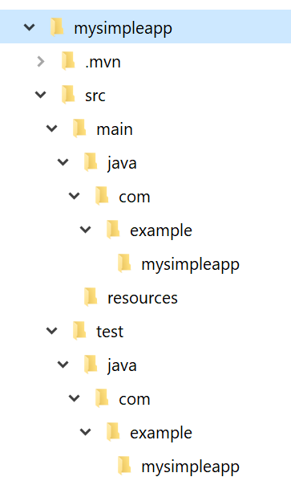
Application Structure
The generated application is a regular Maven project:

Slide 7
Maven POM File
Here are the relevant sections in the Maven POM file:
<project … >
…
<parent>
<groupId>org.springframework.boot</groupId>
<artifactId>spring-boot-starter-parent</artifactId>
<version>2.4.5.RELEASE</version>
<relativePath/>
</parent>
<dependencies>
<dependency>
<groupId>org.springframework.boot</groupId>
<artifactId>spring-boot-starter</artifactId>
</dependency>
<dependency>
<groupId>org.springframework.boot</groupId>
<artifactId>spring-boot-starter-test</artifactId>
<scope>test</scope>
</dependency>
</dependencies>
…
Parent POM
Spring Boot dependency
Spring Boot test dependency
pom.xml

Slide 8
Code Artifacts
Here's the generated application code:
@SpringBootApplication is equivalent to:
@Configuration
@EnableAutoConfiguration
@ComponentScan
import org.springframework.boot.SpringApplication;
import org.springframework.boot.autoconfigure.SpringBootApplication;
@SpringBootApplication
public class DemoApplication {
public static void main(String[] args) {
SpringApplication.run(DemoApplication.class, args);
}
}
DemoApplication.java

Slide 9
Running the Application
You can build/run the app via the mvn command in the mysimpleapp directory as follows:
mvn spring-boot:run

Slide 10
Lesson 2: Creating and Running Spring Boot Applications
2.2 Creating a Web Application Using Spring Boot CLI

Slide 11
Overview
Spring Boot makes it very easy to develop web apps
Include spring-boot-starter-web in your POM
Add web artifacts, e.g., HTML pages, JPEGs, etc.
You typically package the app as a JAR (not a WAR)
Contains a built-in Tomcat web server
You can run it as a standalone Java app

Slide 12
Creating a Web App Using Spring Boot CLI
You can use Spring Boot CLI to create a web app:
The -d option specifies dependencies
We've specified the web dependency
Many other dependencies are available
E.g., jdbc, data-jpa, etc.
spring init -dweb --build maven mywebapp

Slide 13
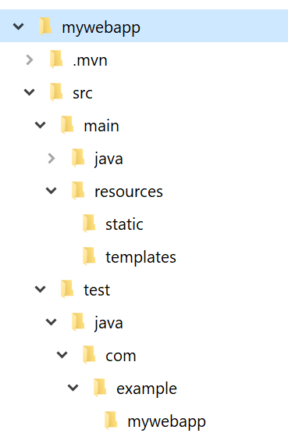
Web Application Structure
The generated app is a regular Maven web project:
Put static web content here

Slide 14
Maven POM File
Here are the relevant sections in the Maven POM file:
<project … >
…
<dependencies>
<dependency>
<groupId>org.springframework.boot</groupId>
<artifactId>spring-boot-starter-web</artifactId>
</dependency>
<dependency>
<groupId>org.springframework.boot</groupId>
<artifactId>spring-boot-starter-test</artifactId>
<scope>test</scope>
</dependency>
</dependencies>
…
Spring Boot web dependency
pom.xml

Slide 15
Adding Web Content
Add static web content in the following directory:
src\main\resources\static
For example, add an index.html file:
<html>
<head>
<title>Home</title>
</head>
<body>
Hello world!
</body>
</html>
index.html

Slide 16
Running the Application
You can build/run the app via the mvn command in the mywebapp directory as follows:
Compiles the code and runs as a standalone Java app
Contains embedded Tomcat server
Tomcat server listens on port 8080
mvn spring-boot:run

Slide 17
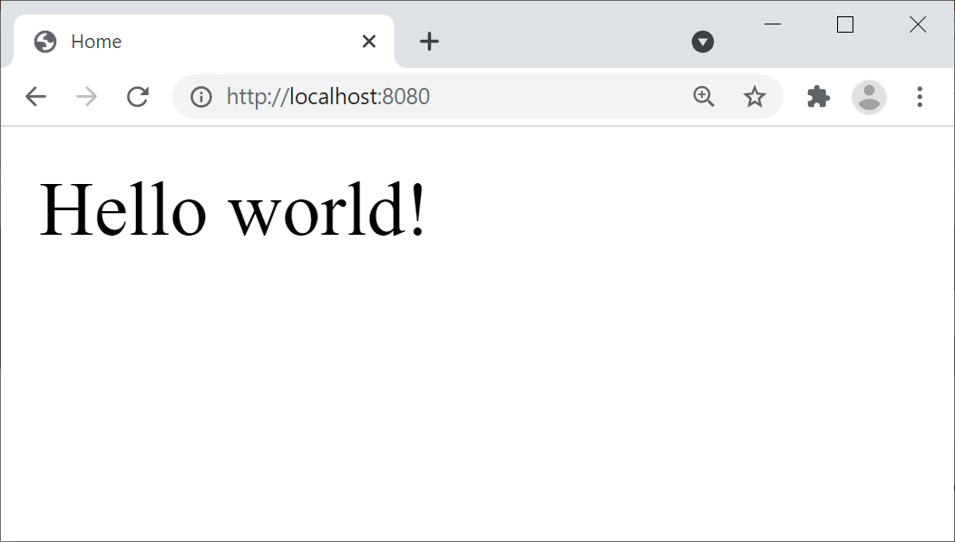
Pinging the Application
Open a browser and go to http://localhost:8080
Renders index.html
This is a standard "welcome" page in Java web apps:

Slide 18
Lesson 2: Creating and Running Spring Boot Applications
2.3 Creating a Web Application Using IntelliJ

Slide 19
Overview of IntelliJ
IntelliJ IDEA Ultimate has excellent support for Spring
Spring Boot and Spring Framework
IntelliJ Java dependencies:
JDK (e.g., JDK 11)
Set JAVA_HOME to the JDK folder
Set PATH to include the JDK binary folder

Slide 20
Creating a Web App Project Using IntelliJ
In IntelliJ, select File | New | Project
Select Spring Initializr, then click Next
Specify project metadata, e.g., Maven, JAR packaging, JDK
Add the Spring Web dependency
Specify the project name and location

Slide 21
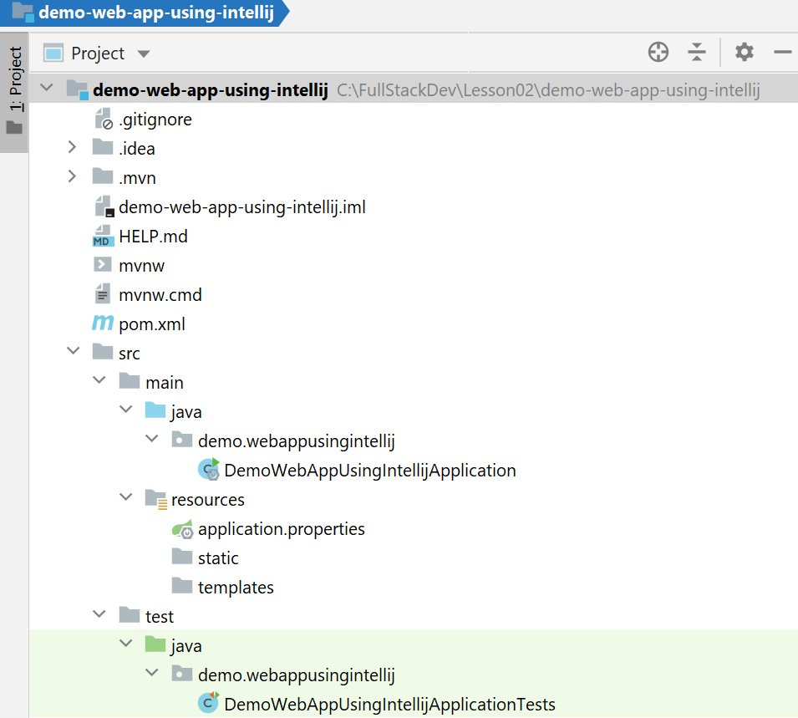
Project Structure
IntelliJ creates a regular Maven web project structure:
Web content goes here

Slide 22
Adding Web Content
In the IntelliJ Project window:
Right-click src\main\resources\static
Click New | HTML File
Enter a file name, e.g., index.html
Enter HTML content, such as:
<html>
<head>
<title>Home</title>
</head>
<body>
Hello world!
</body>
</html>
index.html

Slide 23
Building and Running the Application
To build and run the application:
Right-click the Java file, and click Run
IntelliJ builds the code and runs the application
The application runs Tomcat as an embedded server
To ping the application:
Browse to http://localhost:8080

Slide 24
Lesson 2: Creating and Running Spring Boot Applications
2.4 Implementing a Simple REST Service

Slide 25
Overview
A web application can contain REST services
Provide a façade for server-side functions and data
Easily consumed by any kind of client, over HTTP(S)
To define a simple REST service in Spring Boot:
Define a class annotated with @RestController
Define a method annotated with @RequestMapping

Slide 26
Example REST Service
Example REST service
See project demo-web-app-using-intellij
import org.springframework.web.bind.annotation.RestController;
import org.springframework.web.bind.annotation.RequestMapping;
@RestController
public class GreetingController {
@RequestMapping("/greeting")
public String getGreeting() {
return "Hello from REST service!";
}
}
Designates a REST controller class
Maps the method to a URL
GreetingController.java

Slide 27
Building and Running the Application
To build and run the application:
Right-click the "main" Java file, and click Run
IntelliJ builds the code and runs the application
The application runs Tomcat as an embedded server
To ping the REST service endpoint:
Browse to http://localhost:8080/greeting

Slide 28
Lesson 2: Creating and Running Spring Boot Applications
2.5 Understanding Application Properties

Slide 29
Overview
Spring Boot apps typically make use of many properties
Database connection strings
Server machine names
Message queue names
Etc.
You can define these properties in text files
E.g., application.properties
E.g., application.yml

Slide 30
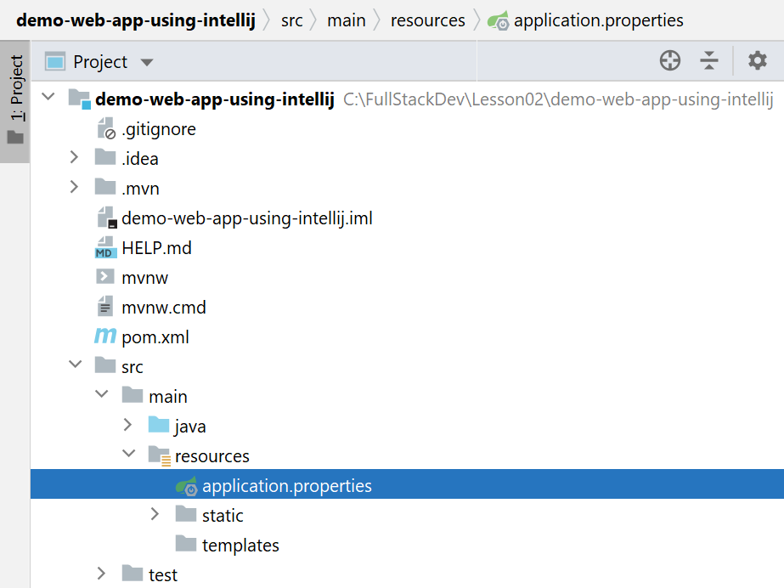
Location of Property Files
Property files are located in src\main\resources:

Slide 31
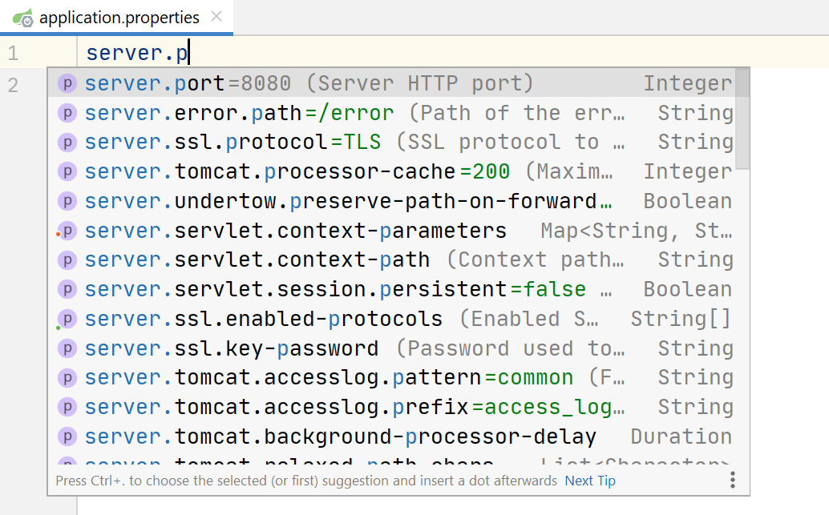
Editing Application Properties
IntelliJ provides IntelliSense to help you edit properties:
server.port=8111

Slide 32
Building and Running the Application
Restart the application in IntelliJ
Verify Tomcat starts on the new port number, e.g., 8111
Ping the application on the new port:
E.g., http://localhost:8111
E.g., http://localhost:8111/greeting

